Slide 1
Chapter 9: Morphological Image Processing
Digital Image Processing
Notes:
Department of Computer Engineering, CMU

Slide 2
Mathematic Morphology
used to extract image components that are useful in the representation and description of region shape, such as
  boundaries extraction
  skeletons
  convex hull
  morphological filtering
  thinning
  pruning

Slide 3
Mathematic Morphology
mathematical framework used for:
pre-processing
  noise filtering, shape simplification, ...
enhancing object structure
  skeletonization, convex hull...
Segmentation
  watershed,…
quantitative description
  area, perimeter, ...

Slide 4
Z² and Z³
set in mathematic morphology represent objects in an image
  binary image (0 = white, 1 = black) : the element of the set is the coordinates (x,y) of pixel belong to the object  Z²
gray-scaled image : the element of the set is the coordinates (x,y) of pixel belong to the object and the gray levels  Z³

Slide 5
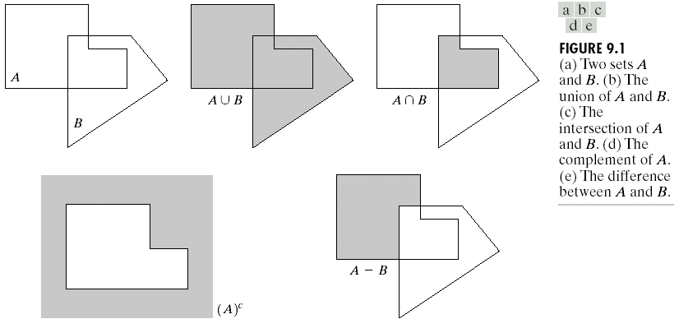
Basic Set Theory

Slide 6
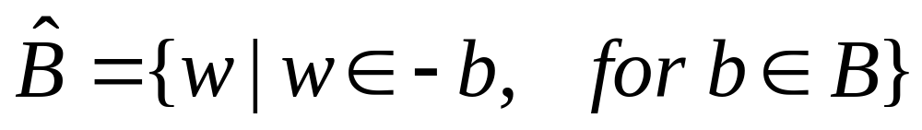

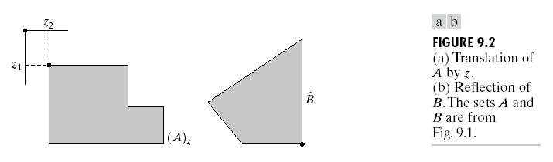
Reflection and Translation

Slide 7
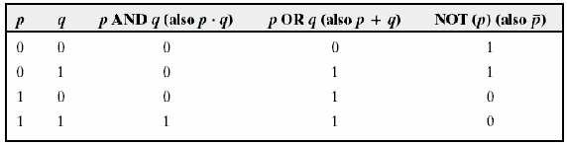
Logic Operations

Slide 8
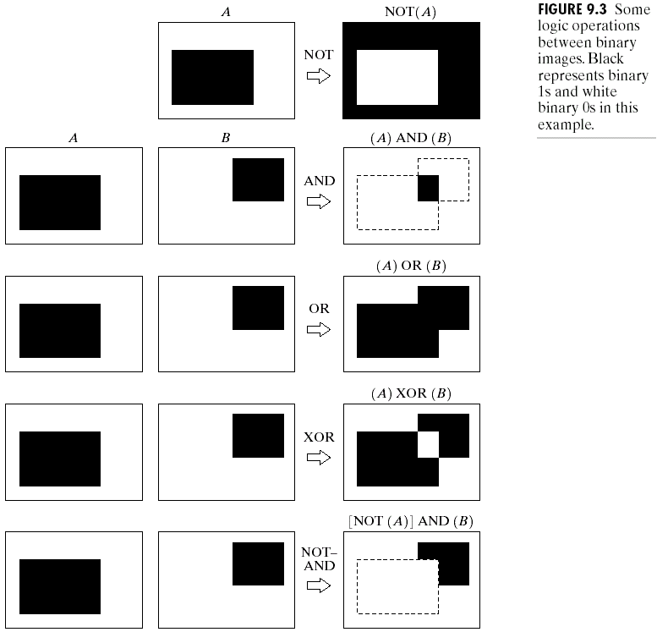
Example

Slide 9

Structuring element (SE)
small set to probe the image under study
for each SE, define origo
shape and size must be adapted to geometric
properties for the objects

Slide 10
Terminology
Structuring Element: It is a matrix or a small-sized template that is used to traverse an image. The structuring element is positioned at all possible locations in the image, and it is compared with the connected pixels. It can be of any shape.
Fit: When all the pixels in the structuring element cover the pixels of the object, we call it Fit.
Hit: When at least one of the pixels in the structuring element cover the pixels of the object, we call it Hit.
Miss: When no pixel in the structuring element cover the pixels of the object, we call it miss.

Slide 11
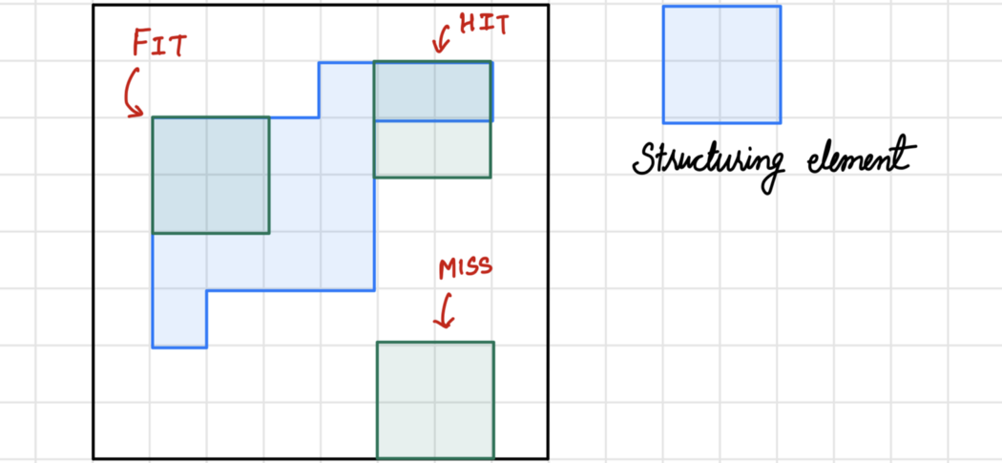
Terminologies explained

Slide 12
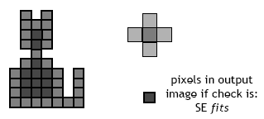
Basic idea
in parallel for each pixel in binary image:
  check if SE is ”satisfied”
  output pixel is set to 0 or 1 depending on used operation

Slide 13
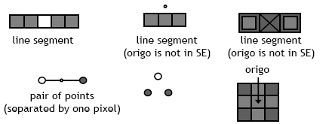
How to describe SE
many different ways!
information needed:
  position of origo for SE
  positions of elements belonging to SE

Slide 14


Basic morphological operations
Erosion
Dilation
combine to
  Opening object
  Closening background
keep general shape but smooth with respect to

Slide 15

Erosion
Does the structuring element fit the set?
erosion of a set A by structuring element B: all z in A such that B is in A when origin of B=z
shrink the object

Slide 16
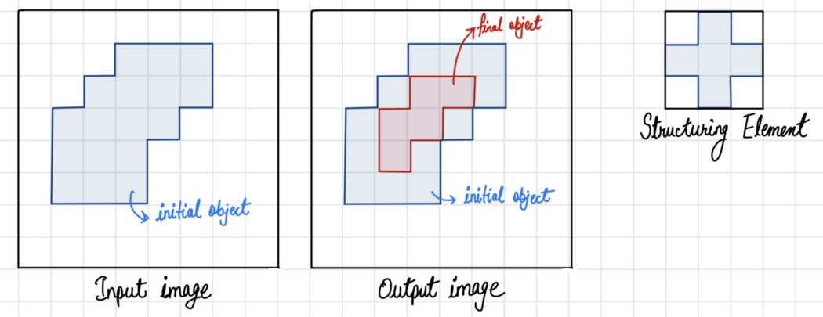
Erosion shrinks the image pixels, or erosion removes pixels on object boundaries. First, we traverse the structuring element over the image object to perform an erosion operation, as shown in Figure The output pixel values are calculated using the following equation.
Pixel (output) = 1 {if FIT}
Pixel (output) = 0 {otherwise}

Slide 17
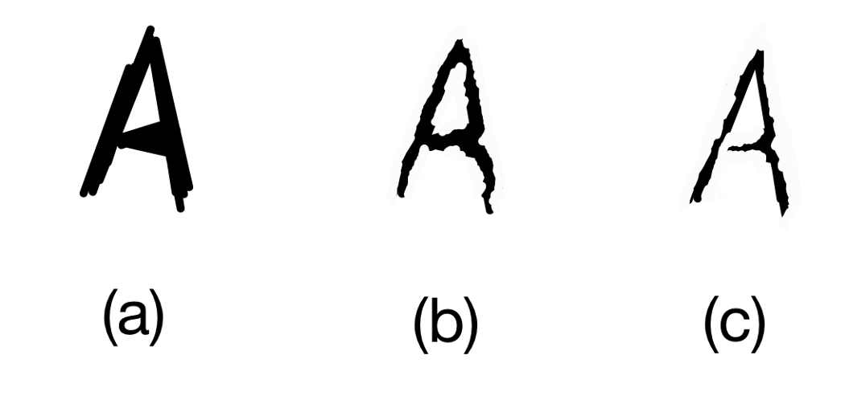
An example of Erosion is shown in Figure , Figure (a) represents original image, (b) and (c) shows processed images after erosion using 3x3 and 5x5 structuring elements, respectively.

Slide 18
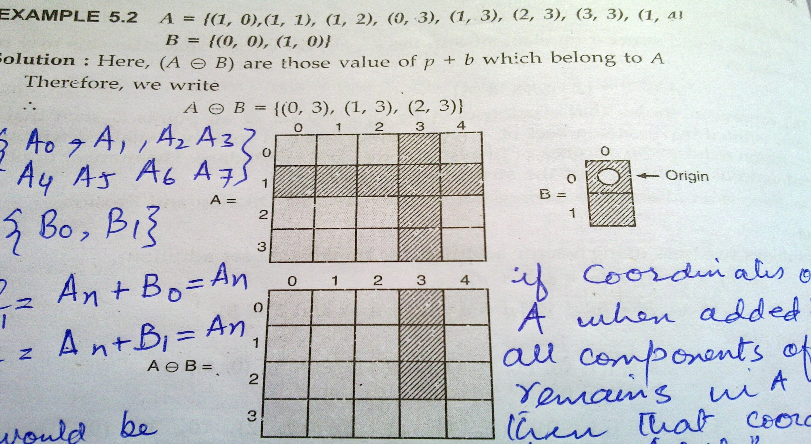

Erosion

Slide 19
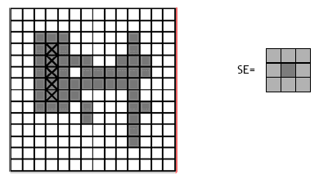
Erosion

Slide 20
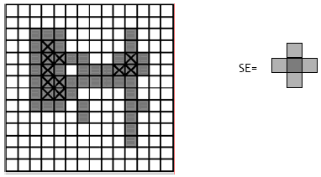
Erosion

Slide 21
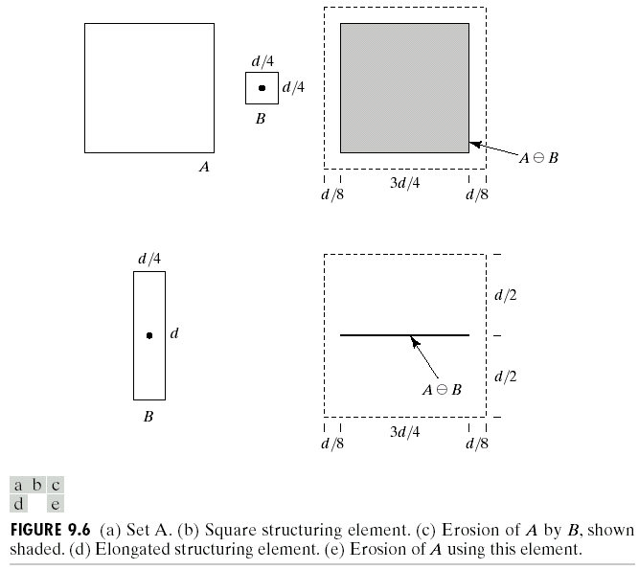
Erosion

Slide 22
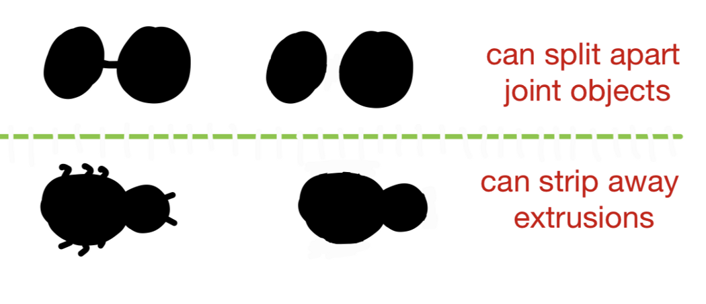
Properties:
It can split apart joint objects (Figure 6).
It can strip away extrusions (Figure 6).

Slide 23
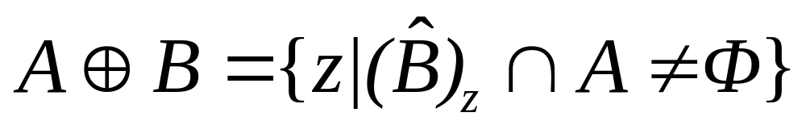
Dilation
Does the structuring element hit the set?
dilation of a set A by structuring element B: all z in A such that B hits A when origin of B=z
grow the object

Slide 24
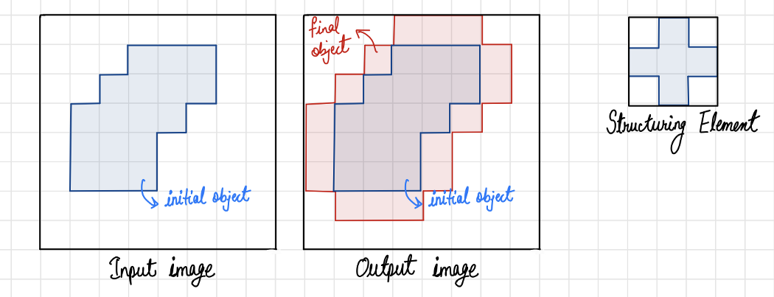
Dialation
Dilation expands the image pixels, or it adds pixels on object boundaries. First, we traverse the structuring element over the image object to perform an dilation operation, as shown in Figure 7. The output pixel values are calculated using the following equation.
Pixel (output) = 1 {if HIT}
Pixel (output) = 0 {otherwise}

Slide 25
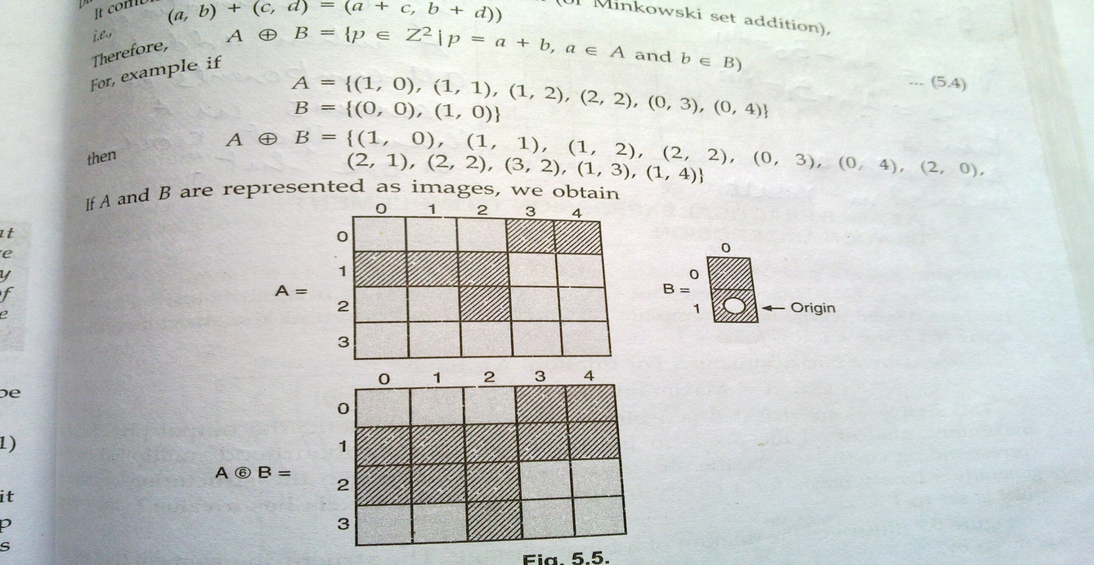
Dilation

Slide 26
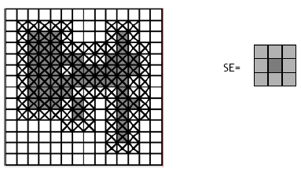
Dilation

Slide 27
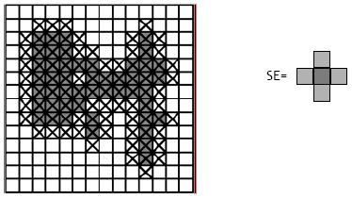
Dilation

Slide 28
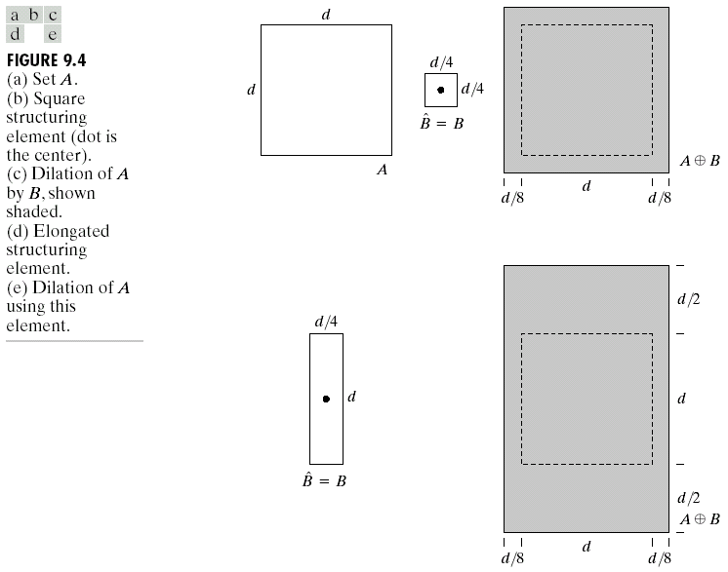
Dilation
B = structuring element

Slide 29
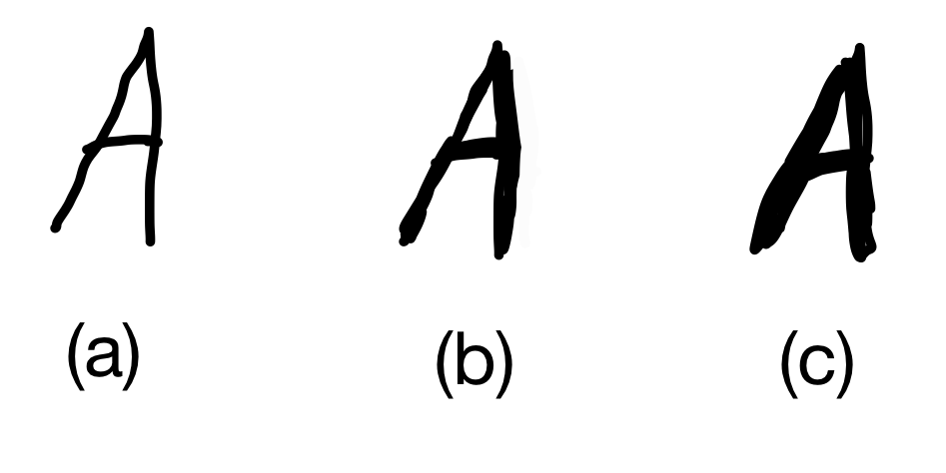
Example
An example of Dilation is shown in Figure. Figure (a) represents an original image, (b) and (c) show processed images after dilation using 3x3 and 5x5 structuring elements, respectively.

Slide 30
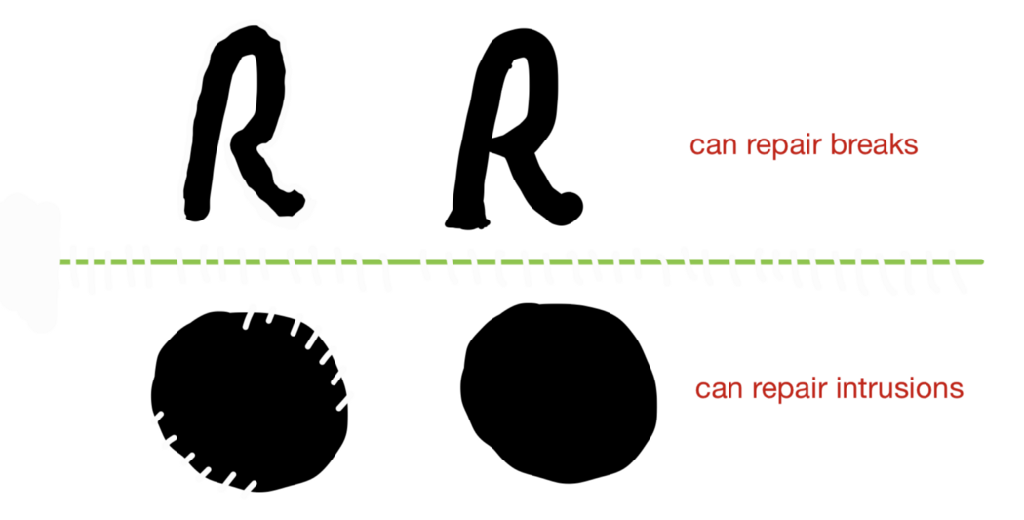
Example
It can repair breaks (Figure 9).
It can repair intrusions (Figure 9).

Slide 31
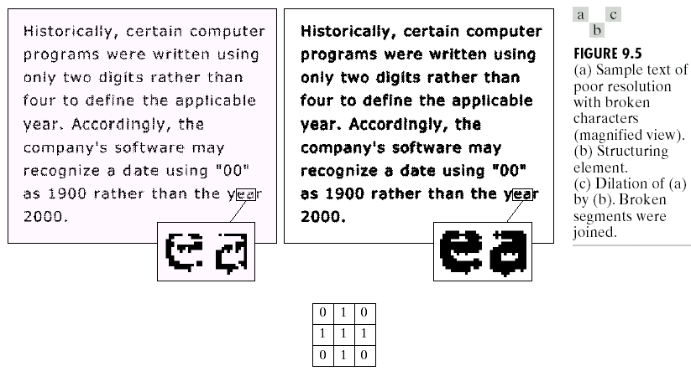
Dilation : Bridging gaps

Slide 32
useful
erosion
  removal of structures of certain shape and size, given by SE
Dilation
  filling of holes of certain shape and size, given by SE

Slide 33
Combining erosion and dilation
WANTED:
  remove structures / fill holes
  without affecting remaining parts
SOLUTION:
combine erosion and dilation
(using same SE)

Slide 34
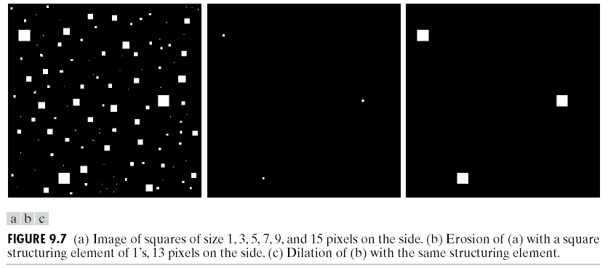
Erosion : eliminating irrelevant detail
structuring element B = 13x13 pixels of gray level 1

Slide 35
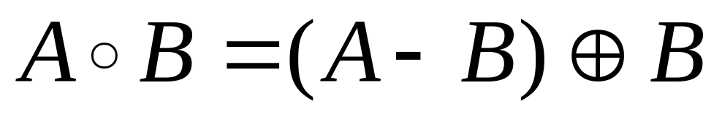
Opening
erosion followed by dilation, denoted ∘
eliminates protrusions
breaks necks
smoothes contour

Slide 36

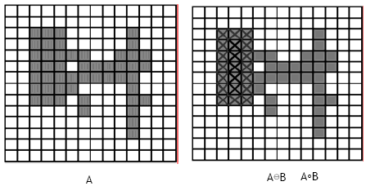
Opening

Slide 37

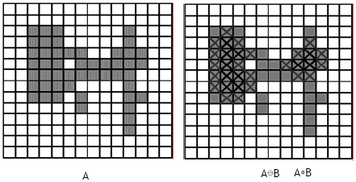
Opening

Slide 38
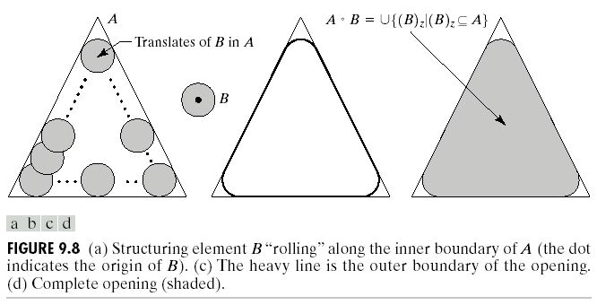

Opening

Slide 39
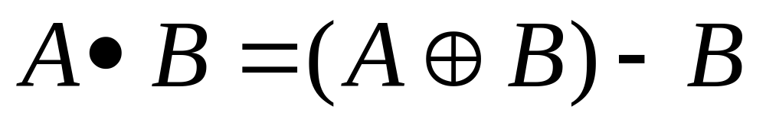
Closing
dilation followed by erosion, denoted •
smooth contour
fuse narrow breaks and long thin gulfs
eliminate small holes
fill gaps in the contour

Slide 40

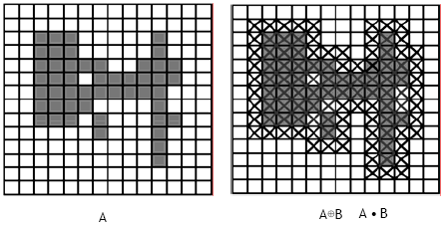
Closing

Slide 41

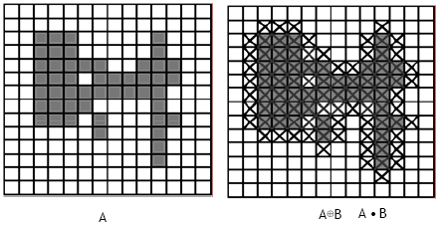
Closing

Slide 42
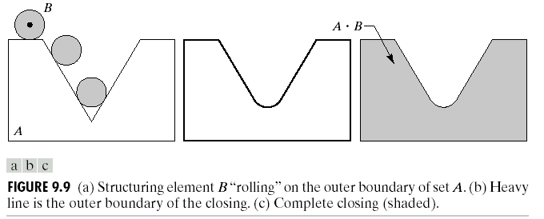
Closing

Slide 43
Properties
Opening
A°B is a subset (subimage) of A
If C is a subset of D, then C °B is a subset of D °B
(A °B) °B = A °B
Closing
A is a subset (subimage) of A•B
If C is a subset of D, then C •B is a subset of D •B
(A •B) •B = A •B
Note: repeated openings/closings has no effect!

Slide 44
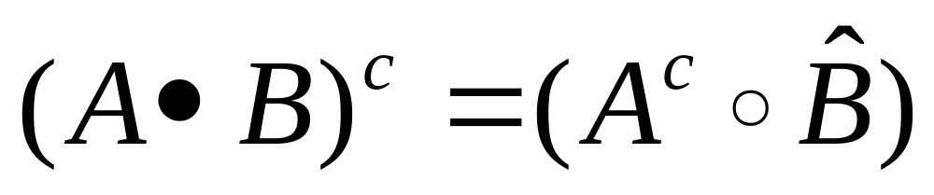
Duality
Opening and closing are dual with respect to complementation and reflection

Slide 45
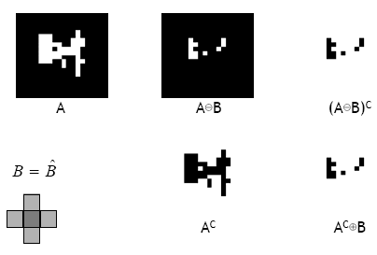

Slide 46
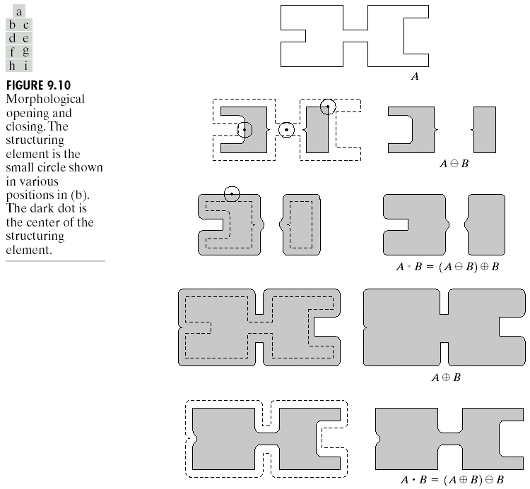

Slide 47
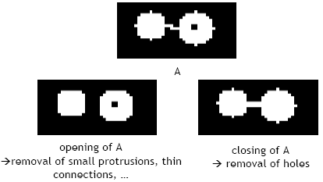
Useful: open & close

Slide 48
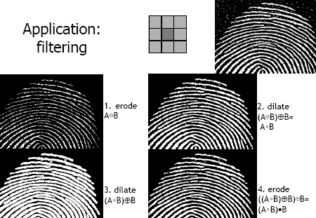
Application: filtering

